Slide 1
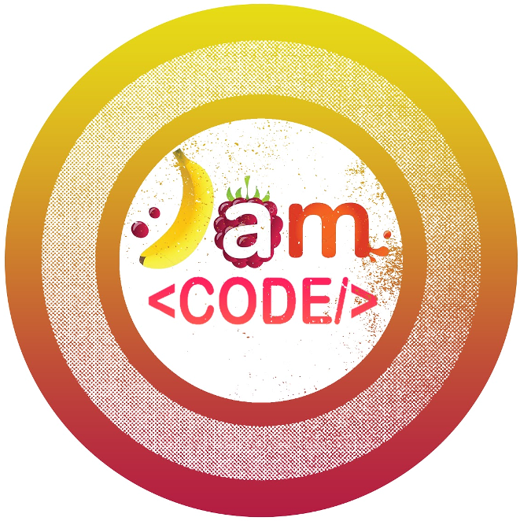

Nascent Machine Learning
Guessing Game

Slide 2

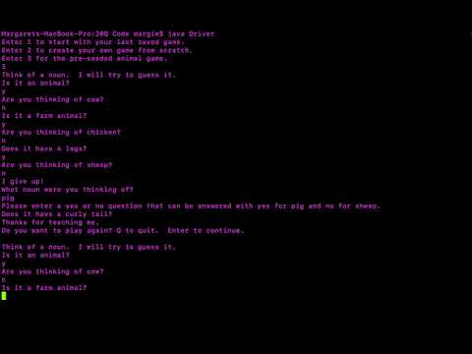

Machine Learning: Guessing Game
Let’s Play: Guessing Game Demo
Notes:
Guessing Game Code Repo: https://github.com/hunter-teacher-cert/summer-2020-topics-project-jam_code/tree/master/20Q%20Code

Slide 3

Machine Learning: Guessing Game
Design your Game
Task 1: Brainstorm
“Procure KtS” & “Summon duckies” -tofr
2. Design your own guessing game flowchart.
-Goal: Put your binary decision tree on paper.
-You can pick the theme (or choose no theme).
-Plan out the questions, guesses, and decisions between.
3. Play “unplugged” Guessing Game with at least two other people.
-Update guessing game decision tree to add any new items as you play.
Notes:
Following this design task, have students share out. Discuss commonalities.
You can find the flowchart for JAM Code’s Game here: https://github.com/hunter-teacher-cert/summer-2020-topics-project-jam_code/blob/master/resources/GuessingGameAnimalSeed.pdf

Slide 4
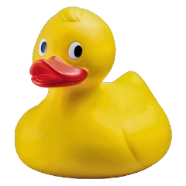

Machine Learning: Guessing Game
Stay Classy
Task 2:
Design & Code Data Structures
1.
“Procure KtS” & “Summon duckies” -tofr
2.
Design the data structures for this project. Think about how the data structures will handle the nouns, questions, and routes. Consider the attributes and methods you will need for your data.
3. Cooooooode <said in an Andrés Cantor voice> those data structures.
need some help or inspiration? Click here --->
Notes:
Following this design task, have students share out. Discuss commonalities.
The data structures YouTube walkthrough is linked for those who need more help. It can also be found here: https://youtu.be/BiZU1GaxMEY
*****
Please forgive the use of the "I" pronoun. This was very much a team project by JAM code. I, the "M" in "JAM", was simply narrating from my perspective.
*****

Slide 5

Machine Learning: Guessing Game
Code
Task 3: Basic Game Play
Write a main method that asks the player questions and traverses a seeded binary decision tree.
***Don’t worry about training the machine yet.***
Start by just determining a win or loss.
Test and debug before moving on!
need some help or inspiration? Click here --->
Notes:
Task 3 is to create a BASIC Guessing Game
Students who need help with the subgoals can check out: https://github.com/hunter-teacher-cert/summer-2020-topics-project-jam_code/blob/master/resources/BasicGamePlay.pdf

Slide 6
Machine Learning: Guessing Game
Nascent Machine Learning
Task 4: Training the Algorithm
The player wins when they beat the algorithm. This means the program reached the end of the decision tree. Consider how you updated your paper Guessing Game (KtS) when a player was thinking of an item NOT located off the branch in your tree. What did you do?
Code method(s) to Add the NEW item AND/OR a question that leads to the item that distinguishes this NEW item from others in the tree.
need some help or inspiration? Click here --->
Notes:
YouTube tutorial on Training the Algorithm: https://youtu.be/ADv_EC2QKg0
*****
Please forgive the use of the "I" pronoun. This was very much a team project by JAM code. I, the "M" in "JAM", was simply narrating from my perspective.
*****

Slide 7
Machine Learning: Guessing Game
Serializing
Congratulations!
If you’re here, your Guessing Game works AND you’ve built a functional machine learning algorithm to teach your game some new items. The only problem is that all of the work you players put into training the algorithm will be lost the moment the game ends. You CAN save the data using Serialization in Java.
Notes:
I aspire to level up to Alex’s Giphy Game. Alas, I accept defeat and accept my role as a mere disciple of his greatness.. All hail Alex, Exalted Ruler of Giphy .
* I’m super tired and my brain has drifted...
Fun Fact: Did you know that “Exalted Ruler” is the official title of the leader of an Elk’s lodge. The Mason’s call their lead “Exalted Master”. I have family members that have held both of those titles. These clubs actually greet their leaders with these titles and straight faces.

Slide 8

Machine Learning: Guessing Game
Serializing
Task 4: Saving the state of the Game
1.
Learn about Serialization:
---> Serialization tutorials & videos
2.
Serialize you code.
3.
-Save the game state at the end of the game.
-Load the game state at the beginning of the game.
need some help or inspiration? Click here --->
Notes:
YouTube Tutorial on Serializing the Data: https://youtu.be/vDh4b0A7_q8
*****
Please forgive the use of the "I" pronoun. This was very much a team project by JAM code. I, the "M" in "JAM", was simply narrating from my perspective.
*****

Slide 9
Machine Learning: Guessing Game
Next Steps
Extensions of this Activity:
-Develop your Guessing Game into a web app.
Notes:
YouTube Tutorial on Serializing the Data: https://youtu.be/vDh4b0A7_q8
*****
Please forgive the use of the "I" pronoun. This was very much a team project by JAM code. I, the "M" in "JAM", was simply narrating from my perspective.
*****

Slide 10
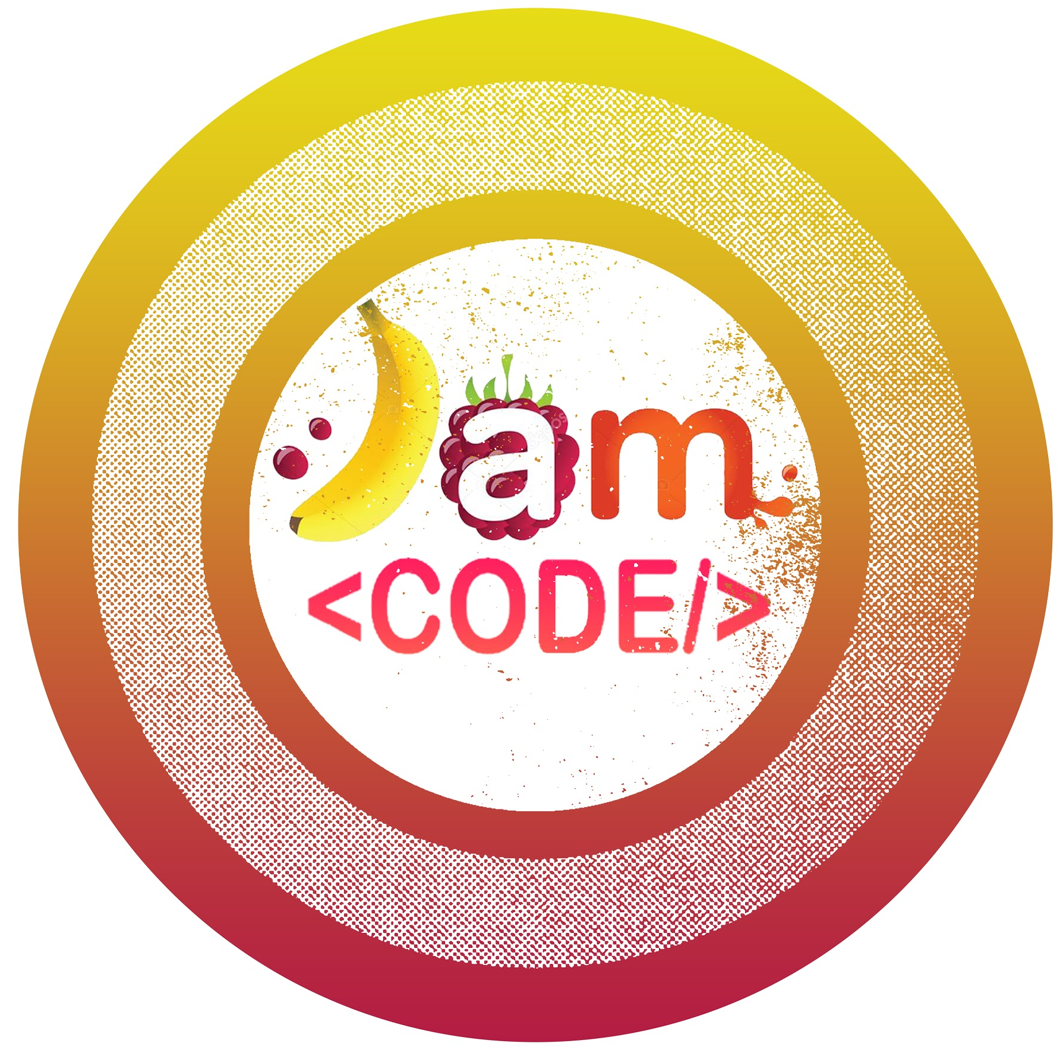
Thank You

